Slide 1
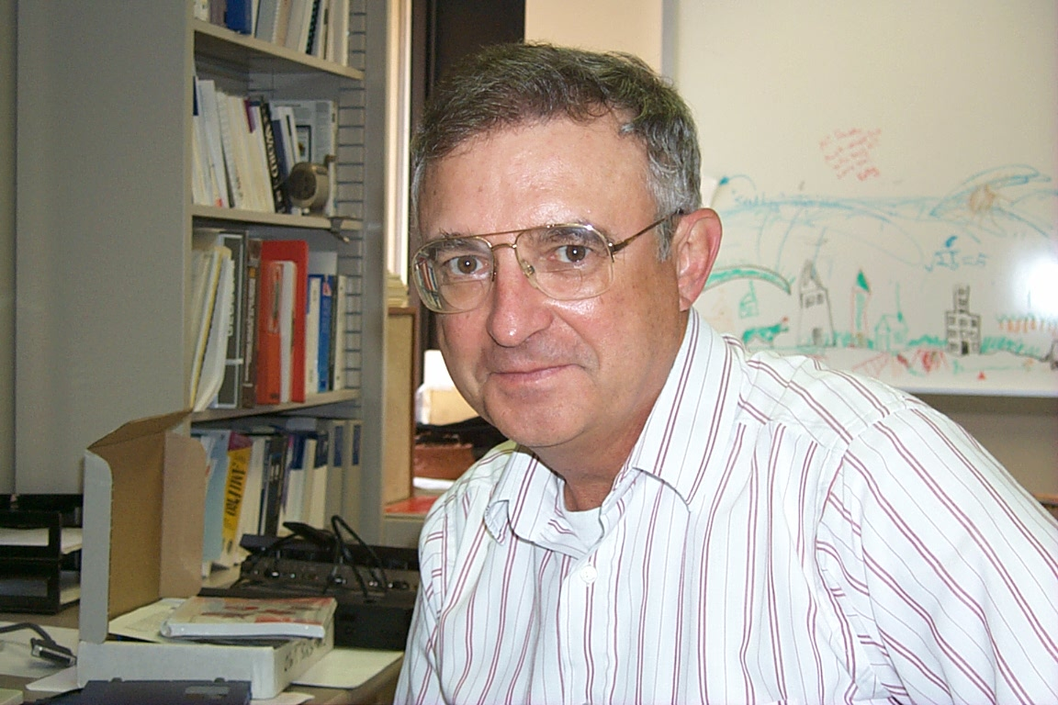
Ken Luza: 1945—2014

Slide 2
Kenneth V. Luza Sept. 26, 1945 — July 23, 2014
Dr. Kenneth V. Luza, longest serving member of the Oklahoma Geological Survey staff, passed away Wednesday morning, July 23, in Norman after a brief illness. Dr. Luza joined the Survey staff in 1977 as an engineering geologist. He is survived by his wife Margaret and son David.
During his career, Dr. Luza worked in all areas of Oklahoma and studied and wrote on all aspects of Oklahoma geology. One of his most important studies was on geologic hazards in northeastern Oklahoma in the area of the Picher Mining District and the Tar Creek Superfund Site, working with water contamination, ground failure and collapse, and contributing in many ways to resolving problems associated with this issue. He worked closely with the people living in the area and cared deeply about their problems and about helping them through the difficult transition period. He worked both with his professional knowledge base, but also with his heart.
His important contributions to Oklahoma as a geologist, but his sly wit and humor will be very much missed by all who knew him. A long-time Survey staff member noted “If Ken Luza told you something you could take that to the bank. He didn’t say things he wasn’t sure about. And he was sure of and right about so much in this State.” Despite his declining health, Ken worked until his last days to complete his investigations.
The OGS Staff and the Mewbourne College would like to express our deepest sympathy to the family and friends who share this loss. Ken will be missed as a geologist and as a friend, and will not be forgotten.

Slide 5
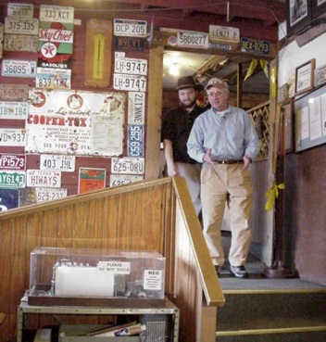
Ken Luza: 1945—2014

Slide 6
Ken Luza: 1945—2014

Slide 7
Ken Luza: 1945—2014

Slide 8
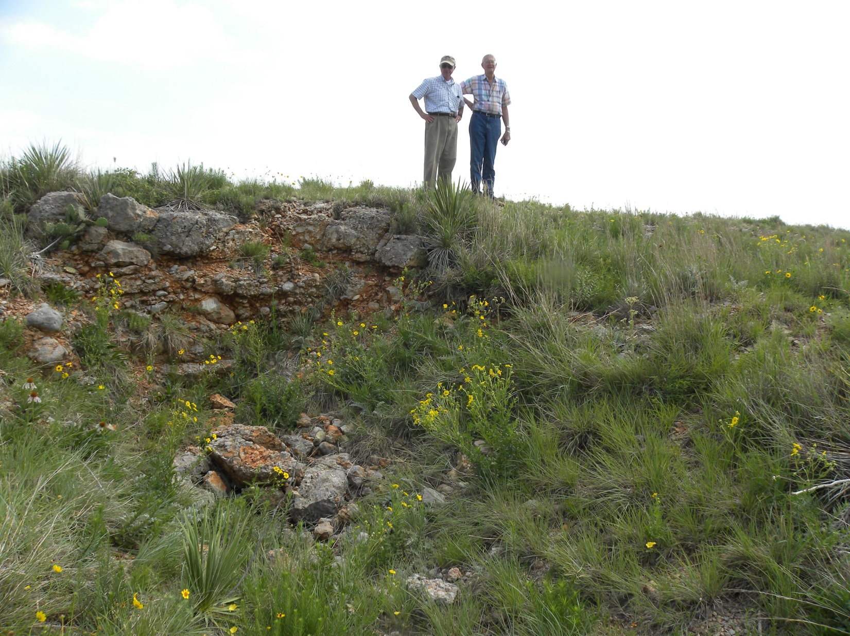
Ken Luza: 1945—2014

Slide 10
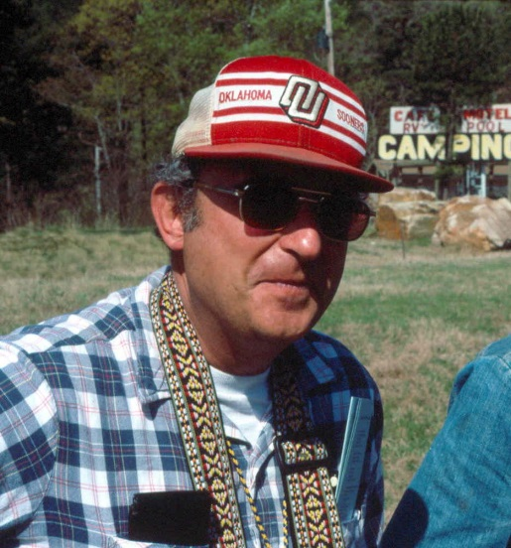
Ken Luza: 1945—2014

Slide 11
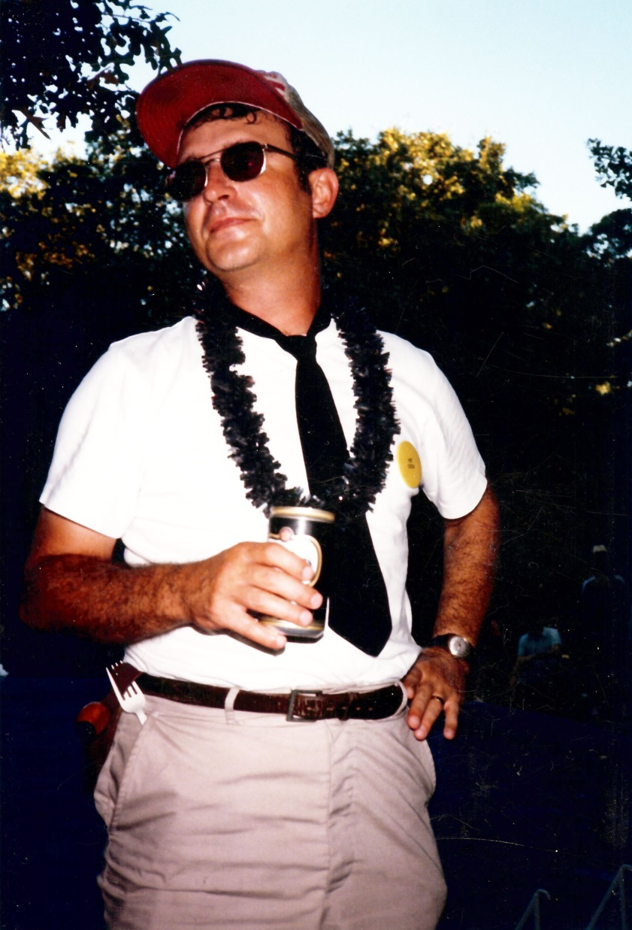
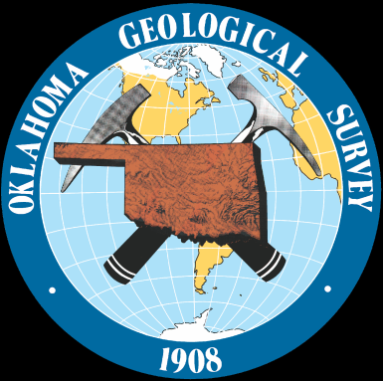
Ken Luza: 1945—2014

